Slide 1

Mastering Python Modules Organize, Reuse, and Enhance Your Code
Photo by Pexels

Slide 2
01
Introduction to Python Modules
Table of Contents
02
Importing Modules in Python
03
Exploring the math Module
04
Understanding the datetime Module
05
Exploring the random Module
06
Utilizing the re Module
07
Working with the json Module
08
Exploring the collections Module
09
Understanding the itertools Module
10
Conclusion: Master Python Modules

Slide 3
1
Introduction to Python Modules
Key Concepts
Python modules are files containing code to define functions, classes, and variables, aiding in code organization and reuse. Modules enable organization, reusability across projects, and create distinct namespaces to prevent identifier conflicts. Usage of modules simplifies code management, promotes code sharing, and enhances code readability and maintenance. Understanding modules is essential for efficient coding practices and building scalable and maintainable projects.
Photo by Pexels

Slide 4

2
Importing Modules in Python
Using the import Keyword
Import modules using the 'import' keyword followed by the module name. Commonly imported modules include math, datetime, random, re, json, collections, and itertools. Each imported module provides a set of functions and classes for specific tasks, enhancing Python's functionalities and capabilities. Importing modules enables access to specialized functionalities, simplifying complex programming tasks and promoting code reusability.
Photo by Pexels

Slide 5
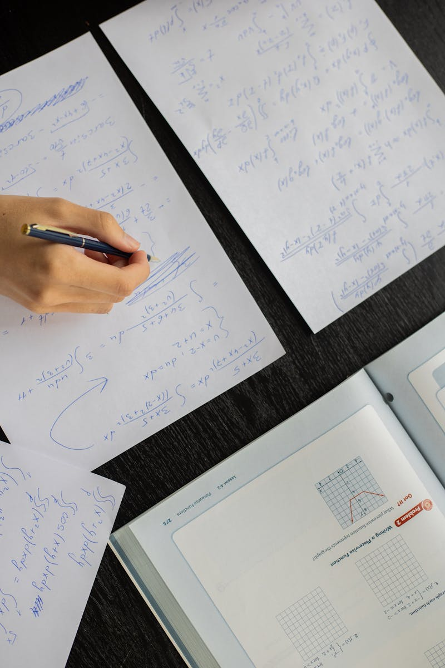
3
Exploring the math Module
Mathematical Functions in Python
The math module in Python offers various mathematical functions and constants for numerical operations. Common functions include trigonometric functions, logarithmic functions, power operations, and rounding functions for mathematical computations. Utilizing math module functions enhances precision in mathematical operations and simplifies complex calculations in Python programs. Integration of math module functions optimizes mathematical computations in Python, improving accuracy and efficiency in data processing tasks.
Photo by Pexels

Slide 6

4
Understanding the datetime Module
Date and Time Manipulation
The datetime module provides classes and methods for manipulating dates and times in Python programs. Functions include obtaining current date and time, creating specific dates, performing date arithmetic, and formatting dates for display. Integration of datetime module functionalities facilitates date-related operations, scheduling tasks, and managing time-sensitive data in Python applications. Utilizing datetime module functionalities enhances date and time management in Python projects, ensuring accurate and efficient handling of temporal data.
Photo by Pexels

Slide 7

5
Exploring the random Module
Pseudo-Random Number Generation
The random module in Python implements pseudo-random number generators for generating random values with various distributions. Functions include generating random numbers, random choice from a list, shuffling lists, and sampling elements from collections for randomness. Incorporating random module functions enhances randomness in Python applications, facilitating simulations, testing, and data manipulation tasks. Utilizing random module functionalities boosts unpredictable behavior in Python programs, adding randomness to simulations and statistical operations.
Photo by Pexels

Slide 8

6
Utilizing the re Module
Regex Matching Operations
The re module in Python provides operations for regular expression pattern matching in strings. Functions include searching for patterns, finding all matches, and replacing patterns in text using regular expressions. Integration of re module functions streamlines text processing, data extraction, and pattern matching tasks in Python applications. Leveraging re module functionalities enhances text processing capabilities and pattern recognition in Python projects, enabling advanced data manipulation.
Photo by Pexels

Slide 9
7
Working with the json Module
JSON Data Handling in Python
The json module in Python offers functions for parsing JSON strings and converting Python objects to JSON format. Functions include converting Python objects to JSON, parsing JSON strings to Python objects, and reading/writing JSON data from/to files. Utilizing json module functions simplifies data exchange, serialization, and storage operations, enhancing interoperability with external systems. Integration of json module functionalities facilitates data communication, API interactions, and data persistence in Python applications, promoting data integration and exchange.
Photo by Pexels

Slide 10

8
Exploring the collections Module
Specialized Container Datatypes
The collections module in Python provides specialized container data types for efficient data storage and manipulation. Classes include named tuple, Counter, defaultdict, and deque for specific data structure requirements in Python programming. Utilizing collections module classes optimizes data handling, simplifies data structure implementations, and enhances data organization in Python applications. Integration of collections module classes streamlines data manipulation, improves data accessibility, and fosters efficient data processing in Python projects.
Photo by Pexels

Slide 11
9
Understanding the itertools Module
Creating Iterators for Efficiency
The itertools module in Python offers functions for creating iterators to iterate over data efficiently and effectively. Functions include infinite iterators, combinatoric iterators for permutations and combinations, and grouping data for iterative processing. Incorporating itertools module functions enhances iteration efficiency, streamlines data processing tasks, and optimizes memory usage in Python programs. Leveraging itertools module functionalities improves data iteration performance, enables advanced looping techniques, and enhances algorithmic implementations in Python projects.
Photo by Pexels

Slide 12

10
Conclusion: Master Python Modules
Enhance Programming Efficiency
Python's standard library provides a rich set of modules and functions that facilitate various programming tasks. Understanding and utilizing Python modules significantly enhance programming skills, code efficiency, and project scalability. Python modules promote code reusability, enhance code modularity, and improve code maintainability, fostering a structured and organized coding practice. Mastering Python modules empowers developers to build robust, scalable, and efficient Python applications for diverse use cases and domains.
Photo by Pexels

